Slide 1
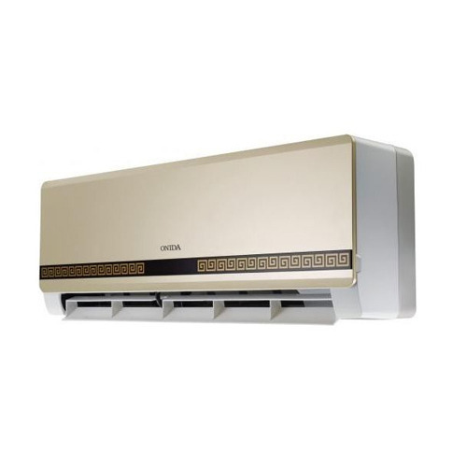
ONIDA AC SERVICE CENTER IN COIMBATORE

Slide 2
INTRODUCTION
Onida AC is worth buying home appliances as they last longer even if its warranty period is over. Onida is one of India's significant cooling system and one of the world's driving exchange arrangement supplier and task master. Presently Day's, each individual has AC in their Home and there is a great interest in the commercial center and At Home Service is putting forth great quality AC Service in Coimbatore. We additionally serve a wide range of Ac's.

Slide 3
AT HOME SERVICE – Quality Onida AC Service in Coimbatore
Looking for the Onida AC Service Center? Your answer to that question has been made simple by choosing At Home Service, the Onida AC Service Center in Coimbatore with no issue.
At that point our expert professional's offers best home services since we care about the total solace and vitality proficiency of your A/C's. Trust AT HOME SERVICE AC Service Center for all your AC fix needs. Your time is important– and you will never be continued pausing. Air conditioning Service focus in Coimbatore offer 24-hour, 7 days, crisis benefit.

Slide 4
REASON TO CHOOSE US
Well prepared professionals.
A bother free Service
Best Quality Work at Low Cost.
Give 100% agreeable work.
Using Best Quality tools.
Handyman can't leave work in mid or fragmented.
Having B-tech Engineer's Team
Work completion in promised Time.
Deals in little and all real work on visiting and contract premise.
Just Call and Get Solution.

Slide 5
ADDITIONAL SERVICES
AC installation
Air Conditioner Fitting
Air Conditioner Dismantling and assembly
AC Gas Charge
Water Wash and Cleaning

Slide 6
CONCLUSION
So, if you want best Onida AC service in Coimbatore, then just give a missed call to 7708110225 or just click on https://www.athomeservice.in/air-conditioner-service/. We have nearly 60 highly qualified AC service Engineers and so they provide with top class service with 100 percent customer satisfaction.

